Slide 1
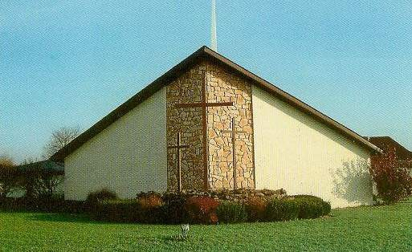
Witnessing
to the Wonders of God –
From His Word to the World
in 2015
Acts 1:8

Slide 2
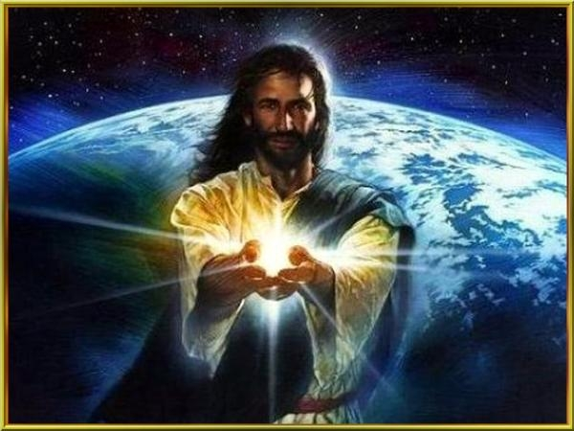
“But you will receive power when the Holy Spirit comes on you,
and you will
be My witnesses”

Slide 3
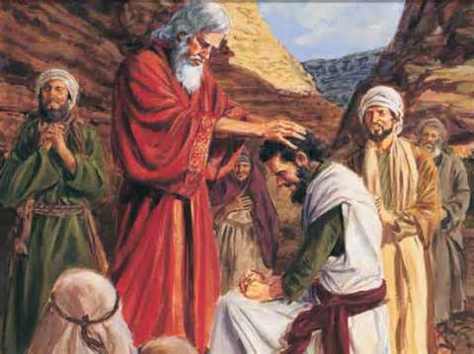
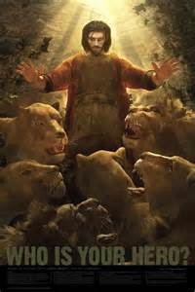
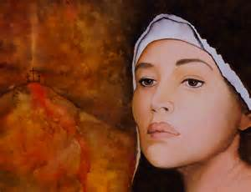
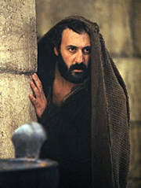
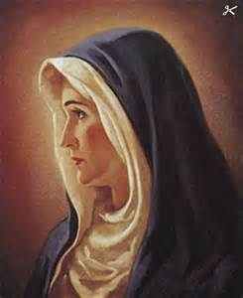
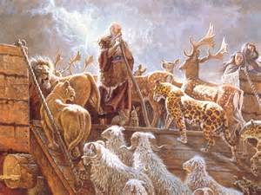
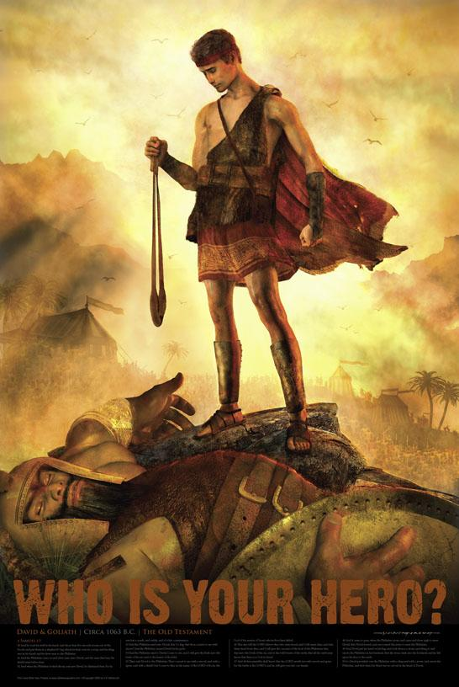
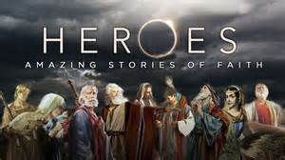
Who is your Bible Hero?

Slide 4
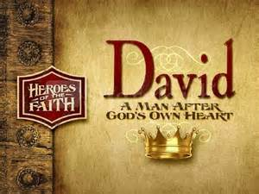
In July: Witness #7: David, A Whole-Hearted Witness for God
A brave-hearted, pure-hearted, broken-hearted man after God’s own heart.

Slide 5
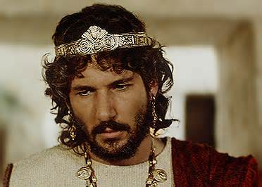
David: Brave - Hearted to Broken - Hearted

Slide 6
II Samuel 18:33 - The king was shaken. He went up to the room over the gateway and wept. As he went, he said: “O my son Absalom! My son, my son Absalom! If only I had died instead of you—O Absalom, my son, my son!”
Psalm 34: 18 - The Lord is close to the brokenhearted, and saves those who are crushed in spirit.
Psalm 51:17 - My sacrifice, O God, is a broken spirit; a broken and contrite heart you, God, will not despise.
Psalm 147:3 - He heals the brokenhearted and binds up their wounds.
Isaiah 57:15 - For this is what the high and exalted One says— he who lives forever, whose name is holy: “I live in a high and holy place, but also with the one who is contrite and lowly in spirit, to revive the spirit of the lowly and to revive the heart of the contrite.
Psalm 61:1-3a - The Spirit of the Sovereign Lord is on me, because the Lord has anointed me to proclaim good news to the poor. He has sent me to bind up the brokenhearted, to proclaim freedom for the captives and release from darkness for the prisoners, ² to proclaim the year of the Lord’s favor and the day of vengeance of our God, to comfort all who mourn, ³ and provide for those who grieve in Zion— to bestow on them a crown of beauty instead of ashes, the oil of joy instead of mourning, and a garment of praise instead of a spirit of despair.
II Corinthians 7:10 - Godly sorrow brings repentance that leads to salvation and leaves no regret, but worldly sorrow brings death.

Slide 7
1. David’s sins caused him grief, sorrow, to be crushed in spirit, brokenhearted, and contrite in heart.

Slide 8
II Samuel 18:33 – The king was shaken. He went up to the room over the gateway and wept. As he went, he said: “O my son Absalom! My son, my son Absalom! If only I had died instead of you—O Absalom, my son, my son!”[
II Samuel 12:10-11a – Now, therefore, the sword will never depart from your house, because you despised me and took the wife of Uriah the Hittite to be your own.’ ¹¹ “This is what the Lord says: ‘Out of your own household I am going to bring calamity on you.
II Samuel 12: 13,14 – Then David said to Nathan, “I have sinned against the Lord.” Nathan replied, “The Lord has taken away your sin. You are not going to die. ¹⁴ But because by doing this you have shown utter contempt for the Lord, the son born to you will die.”
Exodus 20: 5 – You shall not bow down to them or worship them; for I, the Lord your God, am a jealous God, punishing the children for the sin of the parents to the third and fourth generation of those who hate me, ⁶ but showing love to a thousand generations of those who love me and keep my commandments.

Slide 9
Sin can be forgiven, but can also have backlash and repercussions causing pain.

Slide 10
2. God still loves and will forgive, saves (redeems), doesn’t despise, and is close.

Slide 11
Psalm 34:18 – The Lord is close to the brokenhearted and saves those who are crushed in spirit.
Psalm 147:3 – He heals the brokenhearted and binds up their wounds.
Psalm 51:17 – My sacrifice, O God, is a broken spirit; a broken and contrite heart you, God, will not despise
Luke 15: 20-24 – So he got up and went to his father. “But while he was still a long way off, his father saw him and was filled with compassion for him; he ran to his son, threw his arms around him and kissed him. ²¹ “The son said to him, ‘Father, I have sinned against heaven and against you. I am no longer worthy to be called your son.’ ²² “But the father said to his servants, ‘Quick! Bring the best robe and put it on him. Put a ring on his finger and sandals on his feet. ²³ Bring the fattened calf and kill it. Let’s have a feast and celebrate. ²⁴ For this son of mine was dead and is alive again; he was lost and is found.’ So they began to celebrate.
I John 1:9 – If we confess our sins, he is faithful and just and will forgive us our sins and purify us from all unrighteousness.

Slide 12
God doesn’t shoot the wounded, but binds up their wounds, and doesn’t turn away.

Slide 13
3. God’s provisions are healing, freedom, release from darkness, revival, love, comfort, oil of joy, garment of praise, crown of beauty, hope, and restoration.

Slide 14
Psalm 61:1-3a – Hear my cry, O God; listen to my prayer. ² From the ends of the earth I call to you, I call as my heart grows faint; lead me to the rock that is higher than I. ³ For you have been my refuge,
Psalm 51:10-12 – Create in me a pure heart, O God, and renew a steadfast spirit within me. ¹¹ Do not cast me from your presence or take your Holy Spirit from me. ¹² Restore to me the joy of your salvation and grant me a willing spirit, to sustain me.
Isaiah 57:15 – For this is what the high and exalted One says—he who lives forever, whose name is holy: “I live in a high and holy place, but also with the one who is contrite and lowly in spirit, to revive the spirit of the lowly and to revive the heart of the contrite.
II Corinthians 7:10 – Godly sorrow brings repentance that leads to salvation and leaves no regret, but worldly sorrow brings death.
Job 13:15 – Though he slay me, yet will I hope in him…

Slide 15
When we truly repent of our sins, God will forgive, heal, revive, and restore us!

Slide 16
4. Sinning? Stop! Not sinning? Don’t start.

Slide 17
Numbers 5:5-7 – The Lord said to Moses, ⁶ “Say to the Israelites: ‘Any man or woman who wrongs another in any way and so is unfaithful to the Lord is guilty ⁷ and must confess the sin they have committed. They must make full restitution for the wrong they have done, add a fifth of the value to it and give it all to the person they have wronged.
Isaiah 1:16 – Wash and make yourselves clean. Take your evil deeds out of my sight; stop doing wrong.
John 5:14 – Later Jesus found him at the temple and said to him, “See, you are well again. Stop sinning or something worse may happen to you.”
John 8:11 – No one, sir,” she said. “Then neither do I condemn you,” Jesus declared. “Go now and leave your life of sin.”
Romans 8:5 – Those who live according to the flesh have their minds set on what the flesh desires; but those who live in accordance with the Spirit have their minds set on what the Spirit desires.
Proverbs 4: 23 – Above all else, guard your heart, for everything you do flows from it.

Slide 18
Turn and Stay close to God, Let love prevail, and guard your heart.

