Slide 1
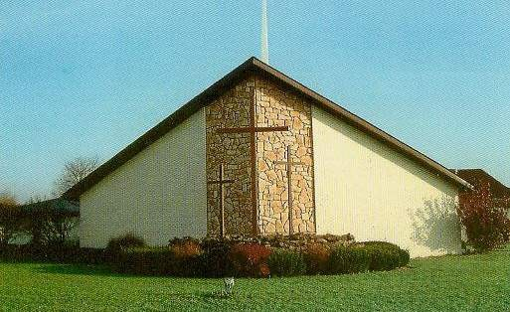
Witnessing to the Wonders of God –
From His Word to the World
in 2015
Acts 1:8

Slide 2
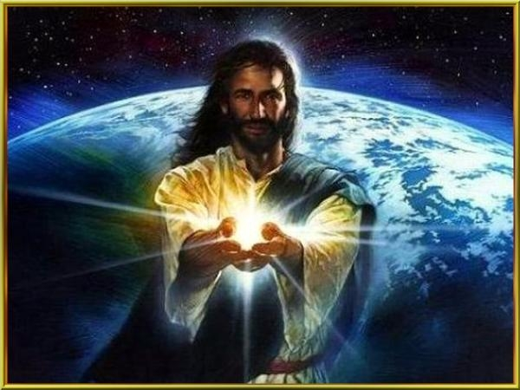
“But you will receive power when the Holy Spirit comes on you, and you will be My witnesses…”

Slide 3
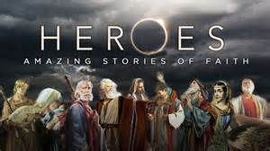
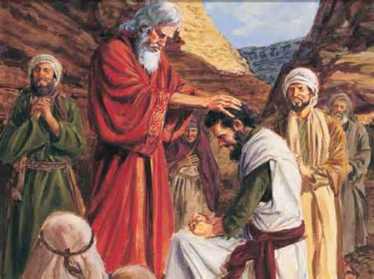
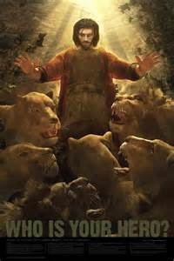
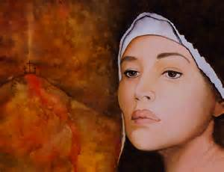
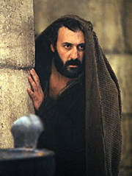
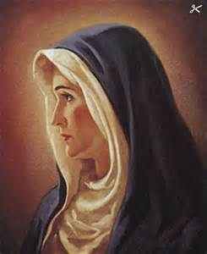
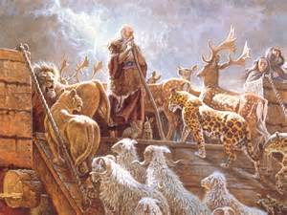
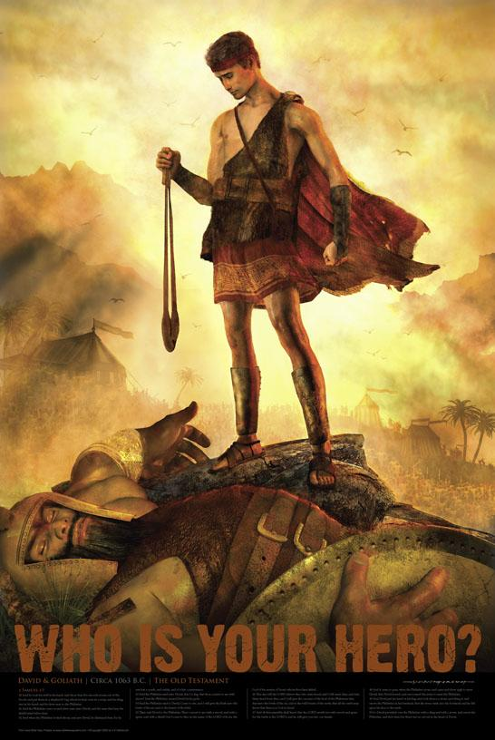
Who is your Bible Hero?

Slide 4
July: Witness #7: David, A Whole-Hearted Witness for God
A brave-hearted, pure-hearted, broken-hearted man after God’s own heart.

Slide 5
I Samuel 17: 32-49 David said to Saul, Let no one lose heart on account of this Philistine; your servant will go and fight him.³³ Saul replied, You are not able to go out against this Philistine and fight him; you are only a young man, and he has been a warrior from his youth.³⁴ But David said to Saul, Your servant has been keeping his father’s sheep. When a lion or a bear came and carried off a sheep from the flock, ³⁵ I went after it, struck it and rescued the sheep from its mouth. When it turned on me, I seized it by its hair, struck it and killed it. ³⁶ Your servant has killed both the lion and the bear; this uncircumcised Philistine will be like one of them, because he has defied the armies of the living God. ³⁷ The Lord who rescued me from the paw of the lion and the paw of the bear will rescue me from the hand of this Philistine. Saul said to David, “Go, and the Lord be with you.³⁸ Then Saul dressed David in his own tunic. He put a coat of armor on him and a bronze helmet on his head. ³⁹ David fastened on his sword over the tunic and tried walking around, because he was not used to them. I cannot go in these, he said to Saul, because I am not used to them. So he took them off. ⁴⁰ Then he took his staff in his hand, chose five smooth stones from the stream, put them in the pouch of his shepherd’s bag and, with his sling in his hand, approached the Philistine.⁴¹ Meanwhile, the Philistine, with his shield bearer in front of him, kept coming closer to David. ⁴² He looked David over and saw that he was little more than a boy, glowing with health and handsome, and he despised him. ⁴³ He said to David, Am I a dog, that you come at me with sticks? And the Philistine cursed David by his gods. ⁴⁴ Come here, he said, and I’ll give your flesh to the birds and the wild animals!⁴⁵ David said to the Philistine, You come against me with sword and spear and javelin, but I come against you in the name of the Lord Almighty, the God of the armies of Israel, whom you have defied. ⁴⁶ This day the Lord will deliver you into my hands, and I’ll strike you down and cut off your head. This very day I will give the carcasses of the Philistine army to the birds and the wild animals, and the whole world will know that there is a God in Israel. ⁴⁷ All those gathered here will know that it is not by sword or spear that the Lord saves; for the battle is the Lord’s, and he will give all of you into our hands.⁴⁸ As the Philistine moved closer to attack him, David ran quickly toward the battle line to meet him. ⁴⁹ Reaching into his bag and taking out a stone, he slung it and struck the Philistine on the forehead. The stone sank into his forehead, and he fell facedown on the ground.

Slide 6
Matthew 14:27 But Jesus immediately said to them: Take courage! It is I. Don’t be afraid.
I Corinthians 16:13 Be on your guard; stand firm in the faith; be courageous; be strong. ¹⁴ Do everything in love.
Ephesians 6:10 Finally, be strong in the Lord and in his mighty power.

Slide 7
David: Young Warrior – Brave Heart

Slide 8
1. With faith in God there is always hope – in the situation and in my heart.

Slide 9
I Samuel 17:32 – David said to Saul, “Let no one lose heart on account of this Philistine; your servant will go and fight him.”
Psalm 121 – I lift up my eyes to the mountains— where does my help come from? ² My help comes from the Lord, the Maker of heaven and earth. ³ He will not let your foot slip— he who watches over you will not slumber; ⁴ indeed, he who watches over Israel will neither slumber nor sleep. ⁵ The Lord watches over you— the Lord is your shade at your right hand; ⁶ the sun will not harm you by day, nor the moon by night. ⁷ The Lord will keep you from all harm— he will watch over your life; ⁸ the Lord will watch over your coming and going both now and forevermore.
John 11:21-23 – Lord,” Martha said to Jesus, “if you had been here, my brother would not have died. ²² But I know that even now God will give you whatever you ask.” ²³ Jesus said to her, “Your brother will rise again.”
Romans 12:9-12 – Love must be sincere. Hate what is evil; cling to what is good. ¹⁰ Be devoted to one another in love. Honor one another above yourselves. ¹¹ Never be lacking in zeal, but keep your spiritual fervor, serving the Lord. ¹² Be joyful in hope, patient in affliction, faithful in prayer.

Slide 10
Let no one lose heart in the troubled times they face today. The giants I face are…

Slide 11
2. Experience builds trust, knowledge, confidence, and deliverance.

Slide 12
I Samuel 17:34-37 – But David said to Saul, “Your servant has been keeping his father’s sheep. When a lion or a bear came and carried off a sheep from the flock, ³⁵ I went after it, struck it and rescued the sheep from its mouth. When it turned on me, I seized it by its hair, struck it and killed it. ³⁶ Your servant has killed both the lion and the bear; this uncircumcised Philistine will be like one of them, because he has defied the armies of the living God. ³⁷ The Lord who rescued me from the paw of the lion and the paw of the bear will rescue me from the hand of this Philistine.” Saul said to David, “Go, and the Lord be with you.”
Proverbs 22:6 – Start children off on the way they should go, and even when they are old they will not turn from it.
Luke 2:52 – And Jesus grew in wisdom and stature, and in favor with God and man.
I Timothy 4:12 – Don’t let anyone look down on you because you are young, but set an example for the believers in speech, in conduct, in love, in faith and in purity.
Hebrews 6: 1-3 – Therefore let us move beyond the elementary teachings about Christ and be taken forward to maturity, not laying again the foundation of repentance from acts that lead to death, and of faith in God, ² instruction about cleansing rites, the laying on of hands, the resurrection of the dead, and eternal judgment. ³ And God permitting, we will do so.
James 1: 2-4 – Consider it pure joy, my brothers and sisters, whenever you face trials of many kinds, ³ because you know that the testing of your faith produces perseverance. ⁴ Let perseverance finish its work so that you may be mature and complete, not lacking anything.

Slide 13
Our first priority today is to train up the children and youth to be strong Disciples.

Slide 14
3. God gives each person their own gifts, strengths, and abilities to do His work.

Slide 15
I Samuel 17:38-40 – Then Saul dressed David in his own tunic. He put a coat of armor on him and a bronze helmet on his head. ³⁹ David fastened on his sword over the tunic and tried walking around, because he was not used to them. “I cannot go in these,” he said to Saul, “because I am not used to them.” So he took them off. ⁴⁰ Then he took his staff in his hand, chose five smooth stones from the stream, put them in the pouch of his shepherd’s bag and, with his sling in his hand, approached the Philistine.
John 21:20-21 – Peter turned and saw that the disciple whom Jesus loved was following them. (This was the one who had leaned back against Jesus at the supper and had said, “Lord, who is going to betray you?”) ²¹ When Peter saw him, he asked, “Lord, what about him?”
I Corinthians 7:7; 12:4-6; 11-12; 27-31 – I wish that all of you were as I am. But each of you has your own gift from God; one has this gift, another has that. There are different kinds of gifts, but the same Spirit distributes them. ⁵ There are different kinds of service, but the same Lord. ⁶ There are different kinds of working, but in all of them and in everyone it is the same God at work. All these are the work of one and the same Spirit, and he distributes them to each one, just as he determines. ¹² Just as a body, though one, has many parts, but all its many parts form one body, so it is with Christ. Now you are the body of Christ, and each one of you is a part of it. ²⁸ And God has placed in the church first of all apostles, second prophets, third teachers, then miracles, then gifts of healing, of helping, of guidance, and of different kinds of tongues. ²⁹ Are all apostles? Are all prophets? Are all teachers? Do all work miracles? ³⁰ Do all have gifts of healing? Do all speak in tongues? Do all interpret? ³¹ Now eagerly desire the greater gifts.

Slide 16
Go with what you know. Work with what you have. To your own self in Christ be true.

Slide 17
4. The battle is the Lord’s. (The war is won.)

Slide 18
I Samuel 17:41-49 – ⁴¹ Meanwhile, the Philistine, with his shield bearer in front of him, kept coming closer to David. ⁴² He looked David over and saw that he was little more than a boy, glowing with health and handsome, and he despised him. ⁴³ He said to David, “Am I a dog, that you come at me with sticks?” And the Philistine cursed David by his gods. ⁴⁴ “Come here,” he said, “and I’ll give your flesh to the birds and the wild animals!” ⁴⁵ David said to the Philistine, “You come against me with sword and spear and javelin, but I come against you in the name of the Lord Almighty, the God of the armies of Israel, whom you have defied. ⁴⁶ This day the Lord will deliver you into my hands, and I’ll strike you down and cut off your head. This very day I will give the carcasses of the Philistine army to the birds and the wild animals, and the whole world will know that there is a God in Israel. ⁴⁷ All those gathered here will know that it is not by sword or spear that the Lord saves; for the battle is the Lord’s, and he will give all of you into our hands.” ⁴⁸ As the Philistine moved closer to attack him, David ran quickly toward the battle line to meet him. ⁴⁹ Reaching into his bag and taking out a stone, he slung it and struck the Philistine on the forehead. The stone sank into his forehead, and he fell facedown on the ground.
II Chronicles 20:15 – He said: “Listen, King Jehoshaphat and all who live in Judah and Jerusalem! This is what the Lord says to you: ‘Do not be afraid or discouraged because of this vast army. For the battle is not yours, but God’s.
Joshua 23:10-11 – One of you routs a thousand, because the Lord your God fights for you, just as he promised. ¹¹ So be very careful to love the Lord your God.
Mark 13:11 – Whenever you are arrested and brought to trial, do not worry beforehand about what to say. Just say whatever is given you at the time, for it is not you speaking, but the Holy Spirit.
Romans 8: 31, 35-37 – What, then, shall we say in response to these things? If God is for us, who can be against us? Who shall separate us from the love of Christ? Shall trouble or hardship or persecution or famine or nakedness or danger or sword? ³⁶ As it is written: “For your sake we face death all day long; we are considered as sheep to be slaughtered.” ³⁷ No, in all these things we are more than conquerors through him who loved us.
Philippians 4:13 – I can do all this through him who gives me strength.

Slide 19
Yes, I am more than a conqueror in Christ ! I can do all things through Him who gives me strength.

