Slide 1
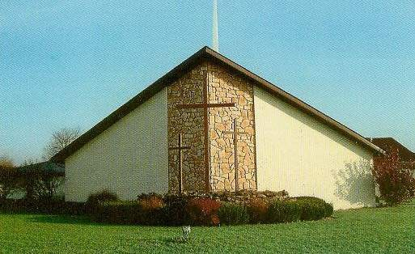
Witnessing to the Wonders
of God –
From His Word to the World
In 2015
Acts 1:8

Slide 2
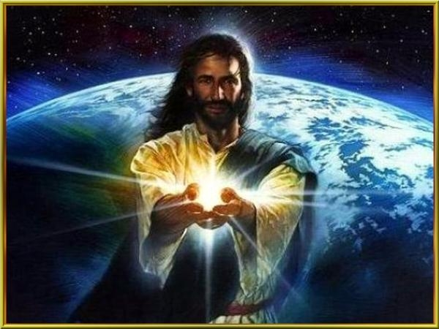
But you will receive power when the Holy Spirit comes on you, and you will be My witnesses…

Slide 3
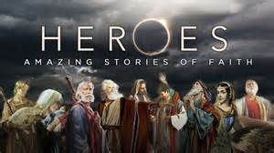
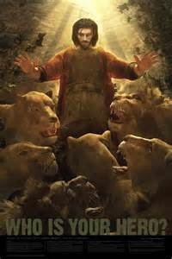
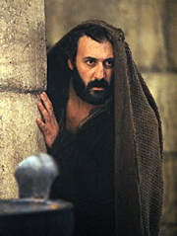
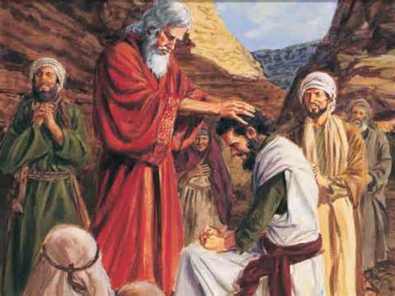
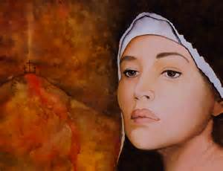
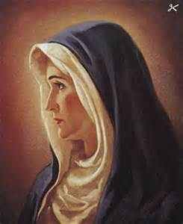
Who is your Bible Hero ?

Slide 4
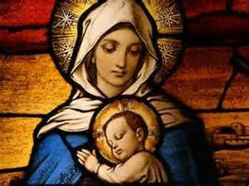
May: Witness #5: Mary, Jesus’ Mother A Willing Witness for God
“I am the Lord’s servant,” Mary answered. “May your word to me be fulfilled.” Luke 1:38 (NIV)

Slide 5
Near the cross of Jesus stood his mother, his mother’s sister, Mary the wife of Clopas, and Mary Magdalene. ²⁶ When Jesus saw his mother there, and the disciple whom he loved standing nearby, he said to her, “Woman, here is your son,” ²⁷ and to the disciple, “Here is your mother.” From that time on, this disciple took her into his home. John 19:25-27
Then the apostles returned to Jerusalem from the hill called the Mount of Olives, a Sabbath day’s walk from the city. ¹³ When they arrived, they went upstairs to the room where they were staying. Those present were Peter, John, James and Andrew; Philip and Thomas, Bartholomew and Matthew; James son of Alphaeus and Simon the Zealot, and Judas son of James. ¹⁴ They all joined together constantly in prayer, along with the women and Mary the mother of Jesus, and with his brothers. Acts 1:12-14
May your father and mother rejoice; may she who gave you birth be joyful! Proverbs 23:25
But Ruth replied, “Don’t urge me to leave you or to turn back from you. Where you go I will go, and where you stay I will stay. Your people will be my people and your God my God. ¹⁷ Where you die I will die, and there I will be buried. May the Lord deal with me, be it ever so severely, if even death separates you and me.” ¹⁸ When Naomi realized that Ruth was determined to go with her, she stopped urging her. Ruth 1: 16-19
At this, she bowed down with her face to the ground. She asked him, “Why have I found such favor in your eyes that you notice me—a foreigner?” ¹¹ Boaz replied, “I’ve been told all about what you have done for your mother-in-law since the death of your husband—how you left your father and mother and your homeland and came to live with a people you did not know before. May the Lord repay you for what you have done. May you be richly rewarded by the Lord, the God of Israel, under whose wings you have come to take refuge.” Ruth 2:10-12
And, I will be a Father to you, and you will be my sons and daughters, says the Lord Almighty.” II Corinthians 6:18

Slide 6
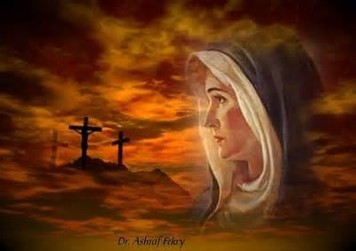
Mary – A Mom Whose Son Died for Others
Thanks for Those Who
Sacrificed for Us.

Slide 7
1. Mary watched Jesus die for the world. He gave His life so others can live free.

Slide 8
John 19: 25 – Near the cross of Jesus stood his mother, his mother’s sister, Mary the wife of Clopas, and Mary Magdalene. ²⁶ When Jesus saw his mother there, and the disciple whom he loved standing nearby, he said to her, “Woman, here is your son,” ²⁷ and to the disciple, “Here is your mother.” From that time on, this disciple took her into his home.
John 15: 13 – Greater love has no one than this: to lay down one’s life for one’s friends.
Matthew 20:28 – just as the Son of Man did not come to be served, but to serve, and to give his life as a ransom for many.”
Romans 5:8 – But God demonstrates his own love for us in this: While we were still sinners, Christ died for us.

Slide 9
Mary’s heart broke when Jesus suffered and died. Jesus’ heart broke for His mom.

Slide 10
2. Jesus took care of his mother’s needs even as He was dying on the cross.

Slide 11
John 19:26-27 – When Jesus saw his mother there, and the disciple whom he loved standing nearby, he said to her, “Woman, here is your son,” ²⁷ and to the disciple, “Here is your mother.” From that time on, this disciple took her into his home.
Acts 1:12-14 – Then the apostles returned to Jerusalem from the hill called the Mount of Olives, a Sabbath day’s walk from the city. ¹³ When they arrived, they went upstairs to the room where they were staying. Those present were Peter, John, James and Andrew; Philip and Thomas, Bartholomew and Matthew; James son of Alphaeus and Simon the Zealot, and Judas son of James. ¹⁴ They all joined together constantly in prayer, along with the women and Mary the mother of Jesus, and with his brothers.

Slide 12
Acts 2:42-47 – They devoted themselves to the apostles’ teaching and to fellowship, to the breaking of bread and to prayer. ⁴³ Everyone was filled with awe at the many wonders and signs performed by the apostles. ⁴⁴ All the believers were together and had everything in common. ⁴⁵ They sold property and possessions to give to anyone who had need. ⁴⁶ Every day they continued to meet together in the temple courts. They broke bread in their homes and ate together with glad and sincere hearts, ⁴⁷ praising God and enjoying the favor of all the people. And the Lord added to their number daily those who were being saved.
Galatians 6:10 – Therefore, as we have opportunity, let us do good to all people, especially to those who belong to the family of believers.
Ephesians 2:19-20 – Consequently, you are no longer foreigners and strangers, but fellow citizens with God’s people and also members of his household, ²⁰ built on the foundation of the apostles and prophets, with Christ Jesus himself as the chief cornerstone.

Slide 13
A new relationship was established from the cross – the relationship of the Church.

Slide 14
3. Mary loved Jesus and was proud of Him.

Slide 15
Proverbs 23:25 – May your father and mother rejoice; may she who gave you birth be joyful!
Exodus 20:12 – “Honor your father and your mother, so that you may live long in the land the Lord your God is giving you.
Luke 2:33 – The child’s father and mother marveled at what was said about him. ³⁴ Then Simeon blessed them and said to Mary, his mother: “This child is destined to cause the falling and rising of many in Israel, and to be a sign that will be spoken against, ³⁵ so that the thoughts of many hearts will be revealed. And a sword will pierce your own soul too.”
Luke 2: 51-52 – Then he went down to Nazareth with them and was obedient to them. But his mother treasured all these things in her heart. ⁵² And Jesus grew in wisdom and stature, and in favor with God and man.
John 2:3-5 – When the wine was gone, Jesus’ mother said to him, “They have no more wine.” ⁴ “Woman, why do you involve me?” Jesus replied. “My hour has not yet come.” ⁵ His mother said to the servants, “Do whatever he tells you.”

Slide 16
Children, live to make your parents proud. Parents, live to make your children strong.

Slide 17
4. Those who live faithful and sacrificially will receive eternal blessings and life!

Slide 18
Ruth 1:16-19 – But Ruth replied, “Don’t urge me to leave you or to turn back from you. Where you go I will go, and where you stay I will stay. Your people will be my people and your God my God. ¹⁷ Where you die I will die, and there I will be buried. May the Lord deal with me, be it ever so severely, if even death separates you and me.” ¹⁸ When Naomi realized that Ruth was determined to go with her, she stopped urging her.
Ruth 2:10-12 – At this, she bowed down with her face to the ground. She asked him, “Why have I found such favor in your eyes that you notice me—a foreigner?” ¹¹ Boaz replied, “I’ve been told all about what you have done for your mother-in-law since the death of your husband—how you left your father and mother and your homeland and came to live with a people you did not know before. May the Lord repay you for what you have done. May you be richly rewarded by the Lord, the God of Israel, under whose wings you have come to take refuge.”
John 3:16 – For God so loved the world that He gave His only begotten Son, that whosoever believes in Him willl not perish, but have everlasting life.
Luke 9:23-24 – The He said to them all: If anyone would come after Me, he must deny himself and take up His cross daily and follow Me. For whoever wants to save his life will lose it, but whoever loses his life for Me will save it.
II Corinthians 6:18 – And, I will be a Father to you, and you will be my sons and daughters, says the Lord Almighty.”

Slide 19
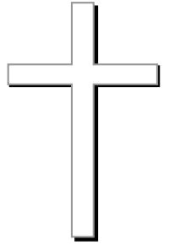
Giving by (One) provides freedom for all !

