Slide 1
Witnessing to the Wonders of God –
From His Word to the World.
Acts 1:8
But you will receive power when the Holy Spirit comes on you, and you will be My witnesses… - Jesus

Slide 2
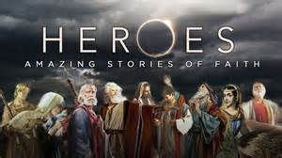
This year we will be celebrating the Biblical witnesses to God’s wonders. Who is your Bible hero?

Slide 3
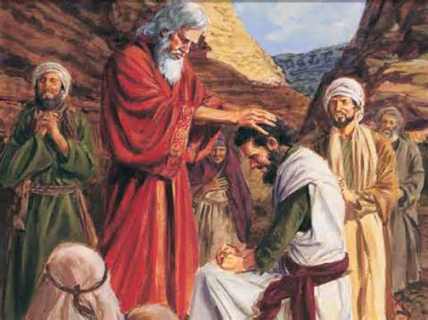
January: WITNESS 1: JOSHUA’S JOURNAL From the wilderness through the promised land, Joshua witnesses to the wonders of God.

Slide 4
Main Scriptures:
The land we passed through and explored is exceedingly good. If the Lord is pleased with us, He will lead us into that land, a land flowing with milk and honey, and will give it to us. Only do not rebel against the Lord. And do not be afraid of the people of the land because we will devour them. Their protection is gone but the Lord is with us. Do not be afraid of them. Numbers 14:5-9
Be strong and courageous, because you will lead these people to inherit the land I swore to their ancestors to give them. “Be strong and very courageous. Be careful to obey all the law my servant Moses gave you; do not turn from it to the right or to the left, that you may be successful wherever you go. Keep this Book of the Law always on your lips; meditate on it day and night, so that you may be careful to do everything written in it. Then you will be prosperous and successful….Be strong and courageous. Do not be afraid; do not be discouraged, for the Lord your God will be with you wherever you go.” Joshua 1: 1-9

Slide 5
Joshua got up early the next morning and the priests took up the ark of the Lord. The seven priests carrying the seven trumpets went forward, marching before the ark of the Lord and blowing the trumpets. The armed men went ahead of them and the rear guard followed the ark of the Lord, while the trumpets kept sounding. So on the second day they marched around the city once and returned to the camp. They did this for six days. On the seventh day, they got up at daybreak and marched around the city seven times in the same manner, except that on that day they circled the city seven times. The seventh time around, when the priests sounded the trumpet blast, Joshua commanded the army, “Shout! For the Lord has given you the city! The city and all that is in it are to be devoted to the Lord.…When the trumpets sounded, the army shouted, and at the sound of the trumpet, when the men gave a loud shout, the wall collapsed; so everyone charged straight in, and they took the city. Joshua 6: 12-20
“Now fear the Lord and serve Him with all faithfulness. Throw away the gods your ancestors worshiped beyond the Euphrates River and in Egypt, and serve the Lord. But if serving the Lord seems undesirable to you, then choose for yourselves this day whom you will serve, whether the gods your ancestors served beyond the Euphrates, or the gods of the Amorites, in whose land you are living. But as for me and my household, we will serve the Lord.” Joshua 24: 14-15

Slide 6
Supporting Scriptures:
Does the Lord delight in burnt offerings and sacrifices as much as in obeying the Lord? To obey is better than sacrifice.
I Samuel 15:22
He replied, Blessed rather are those who hear the word of God and obey it.
Luke 11:28
Peter and the other apostles replied: We must obey God rather than human beings! Acts 5:29

Slide 7
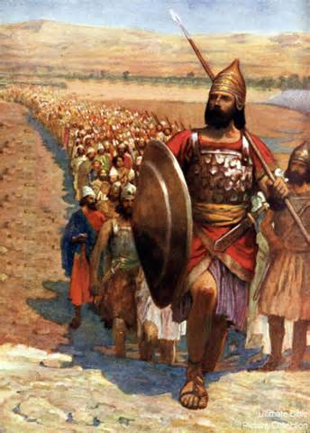
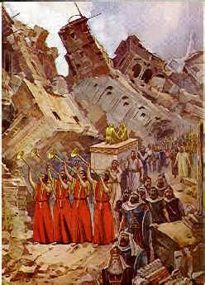
A Leader Who
Obeys God’s Commands
When all heed the call, the wall(s) will fall !

Slide 8
1.
Get an Early Start with God.

Slide 9
Joshua 6:12-20 – Joshua got up early the next morning and the priests took up the ark of the Lord. ¹³ The seven priests carrying the seven trumpets went forward, marching before the ark of the Lord and blowing the trumpets. The armed men went ahead of them and the rear guard followed the ark of the Lord, while the trumpets kept sounding. ¹⁴ So on the second day they marched around the city once and returned to the camp. They did this for six days. ¹⁵ On the seventh day, they got up at daybreak and marched around the city seven times in the same manner, except that on that day they circled the city seven times. ¹⁶ The seventh time around, when the priests sounded the trumpet blast, Joshua commanded the army, “Shout! For the Lord has given you the city! ¹⁷ The city and all that is in it are to be devoted to the Lord. Only Rahab the prostitute and all who are with her in her house shall be spared, because she hid the spies we sent. ¹⁸ But keep away from the devoted things, so that you will not bring about your own destruction by taking any of them. Otherwise you will make the camp of Israel liable to destruction and bring trouble on it. ¹⁹ All the silver and gold and the articles of bronze and iron are sacred to the Lord and must go into his treasury.” ²⁰ When the trumpets sounded, the army shouted, and at the sound of the trumpet, when the men gave a loud shout, the wall collapsed; so everyone charged straight in, and they took the city.

Slide 10
Psalm 5:3 – In the morning, Lord, You hear my voice; in the morning I lay my requests before You and wait expectantly.
Psalm 119:147 – I rise before dawn and cry for help; I have put my hope in Your word.
Mark 1:35 – Very early in the morning, while it was still dark, Jesus got up, left the house and went off to a solitary place, where He prayed.
Revelation 22:12-13 – Look, I am coming soon! My reward is with Me, and I will give to each person according to what they have done. ¹³ I am the Alpha and the Omega, the First and the Last, the Beginning and the End.

Slide 11
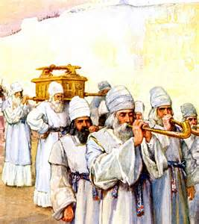
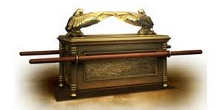
What/When is my
morning “ark of the covenant”?

Slide 12
2.
Make Triumphant Joyful Music for God.

Slide 13
Joshua 6:12-20 – Joshua got up early the next morning and the priests took up the ark of the Lord. ¹³ The seven priests carrying the seven trumpets went forward, marching before the ark of the Lord and blowing the trumpets. The armed men went ahead of them and the rear guard followed the ark of the Lord, while the trumpets kept sounding. ¹⁴ So on the second day they marched around the city once and returned to the camp. They did this for six days. ¹⁵ On the seventh day, they got up at daybreak and marched around the city seven times in the same manner, except that on that day they circled the city seven times. ¹⁶ The seventh time around, when the priests sounded the trumpet blast, Joshua commanded the army, “Shout! For the Lord has given you the city! ¹⁷ The city and all that is in it are to be devoted^{[a]} to the Lord. Only Rahab the prostitute and all who are with her in her house shall be spared, because she hid the spies we sent. ¹⁸ But keep away from the devoted things, so that you will not bring about your own destruction by taking any of them. Otherwise you will make the camp of Israel liable to destruction and bring trouble on it. ¹⁹ All the silver and gold and the articles of bronze and iron are sacred to the Lord and must go into his treasury.” ²⁰ When the trumpets sounded, the army shouted, and at the sound of the trumpet, when the men gave a loud shout, the wall collapsed; so everyone charged straight in, and they took the city.

Slide 14
Psalm 100: 2 – Worship the Lord with gladness; come before him with joyful songs.
Psalm 108:1 – My heart, O God, is steadfast; I will sing and make music with all my soul.
Ephesians 5:19 – Do not get drunk on wine, which leads to debauchery. Instead, be filled with the Spirit, ¹⁹ speaking to one another with psalms, hymns, and songs from the Spirit. Sing and make music from your heart to the Lord, ²⁰ always giving thanks to God the Father for everything, in the name of our Lord Jesus Christ.

Slide 15
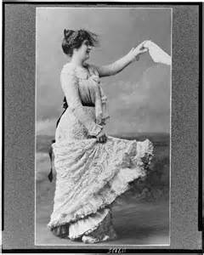
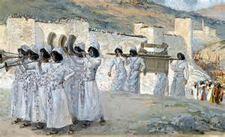
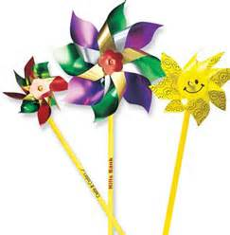
Let’s blow the trumpet,
play instruments, sing praises, wave hankies, spin wee-mills.

Slide 16
3.
Repeat 1 and 2 - on and on and on.

Slide 17
Joshua 6:12-20 – Joshua got up early the next morning and the priests took up the ark of the Lord. ¹³ The seven priests carrying the seven trumpets went forward, marching before the ark of the Lord and blowing the trumpets. The armed men went ahead of them and the rear guard followed the ark of the Lord, while the trumpets kept sounding. ¹⁴ So on the second day they marched around the city once and returned to the camp. They did this for six days. ¹⁵ On the seventh day, they got up at daybreak and marched around the city seven times in the same manner, except that on that day they circled the city seven times. ¹⁶ The seventh time around, when the priests sounded the trumpet blast, Joshua commanded the army, “Shout! For the Lord has given you the city! ¹⁷ The city and all that is in it are to be devoted^{[a]} to the Lord. Only Rahab the prostitute and all who are with her in her house shall be spared, because she hid the spies we sent. ¹⁸ But keep away from the devoted things, so that you will not bring about your own destruction by taking any of them. Otherwise you will make the camp of Israel liable to destruction and bring trouble on it. ¹⁹ All the silver and gold and the articles of bronze and iron are sacred to the Lord and must go into his treasury.” ²⁰ When the trumpets sounded, the army shouted, and at the sound of the trumpet, when the men gave a loud shout, the wall collapsed; so everyone charged straight in, and they took the city.

Slide 18
Nehemiah 8:18 – Day after day, from the first day to the last, Ezra read from the Book of the Law of God. They celebrated the festival for seven days, and on the eighth day, in accordance with the regulation, there was an assembly.
Psalm 119:34 – Give me understanding, so that I may keep your law and obey it with all my heart.
Luke 9:23 – Then He said to them all: “Whoever wants to be My disciple must deny themselves and take up their cross daily and follow Me.
Acts 2:46 – Every day they continued to meet together in the temple courts.

Slide 19
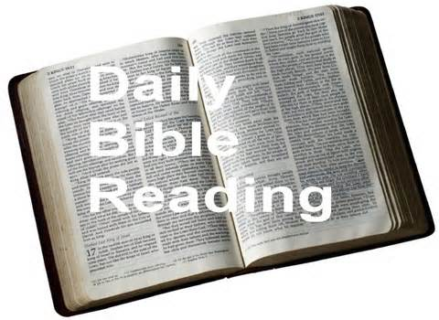
I will get in the habit of always obeying God’s Word daily no matter what.

Slide 20
4.
Shout-out
a glorious praise to God !

Slide 21
Joshua 6: 9-20 – The armed guard marched ahead of the priests who blew the trumpets, and the rear guard followed the ark. All this time the trumpets were sounding. ¹⁰ But Joshua had commanded the army, “Do not give a war cry, do not raise your voices, do not say a word until the day I tell you to shout. Then shout!” ¹¹ So he had the ark of the Lord carried around the city, circling it once. Then the army returned to camp and spent the night there. ¹² Joshua got up early the next morning and the priests took up the ark of the Lord. ¹³ The seven priests carrying the seven trumpets went forward, marching before the ark of the Lord and blowing the trumpets. The armed men went ahead of them and the rear guard followed the ark of the Lord, while the trumpets kept sounding. ¹⁴ So on the second day they marched around the city once and returned to the camp. They did this for six days. ¹⁵ On the seventh day, they got up at daybreak and marched around the city seven times in the same manner, except that on that day they circled the city seven times. ¹⁶ The seventh time around, when the priests sounded the trumpet blast, Joshua commanded the army, “Shout! For the Lord has given you the city! ¹⁷ The city and all that is in it are to be devoted to the Lord. Only Rahab the prostitute and all who are with her in her house shall be spared, because she hid the spies we sent. ¹⁸ But keep away from the devoted things, so that you will not bring about your own destruction by taking any of them. Otherwise you will make the camp of Israel liable to destruction and bring trouble on it. ¹⁹ All the silver and gold and the articles of bronze and iron are sacred to the Lord and must go into his treasury.” ²⁰ When the trumpets sounded, the army shouted, and at the sound of the trumpet, when the men gave a loud shout, the wall collapsed; so everyone charged straight in, and they took the city.

Slide 22
Leviticus 9:23-24 – Moses and Aaron then went into the tent of meeting. When they came out, they blessed the people; and the glory of the Lord appeared to all the people. ²⁴ Fire came out from the presence of the Lord and consumed the burnt offering and the fat portions on the altar. And when all the people saw it, they shouted for joy and fell facedown.
Psalm 100:1 – Shout for joy to the Lord, all the earth. Ecclesiastes 3:7 – a time to tear and a time to mend, a time to be silent and a time to speak, Luke 19:37-40 – When he came near the place where the road goes down the Mount of Olives, the whole crowd of disciples began joyfully to praise God in loud voices for all the miracles they had seen: ³⁸ “Blessed is the king who comes in the name of the Lord!” “Peace in heaven and glory in the highest!” ³⁹ Some of the Pharisees in the crowd said to Jesus, “Teacher, rebuke your disciples!” ⁴⁰ “I tell you,” he replied, “if they keep quiet, the stones will cry out.”

Slide 23
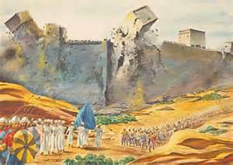
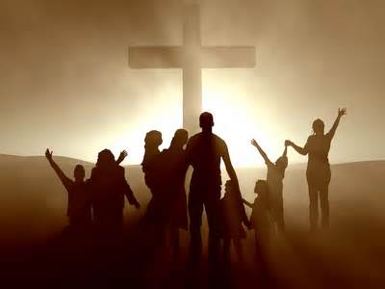
Sing, Shout, Bow, Raise !
Shout to the North!
Shout to the Lord!
We’ll sing and shout the victory!

Slide 24
5.
Wonder of God - Walls (of Jericho) Fall.

Slide 25
Joshua 6:12-20 – Joshua got up early the next morning and the priests took up the ark of the Lord. ¹³ The seven priests carrying the seven trumpets went forward, marching before the ark of the Lord and blowing the trumpets. The armed men went ahead of them and the rear guard followed the ark of the Lord, while the trumpets kept sounding. ¹⁴ So on the second day they marched around the city once and returned to the camp. They did this for six days. ¹⁵ On the seventh day, they got up at daybreak and marched around the city seven times in the same manner, except that on that day they circled the city seven times. ¹⁶ The seventh time around, when the priests sounded the trumpet blast, Joshua commanded the army, “Shout! For the Lord has given you the city! ¹⁷ The city and all that is in it are to be devoted to the Lord. Only Rahab the prostitute and all who are with her in her house shall be spared, because she hid the spies we sent. ¹⁸ But keep away from the devoted things, so that you will not bring about your own destruction by taking any of them. Otherwise you will make the camp of Israel liable to destruction and bring trouble on it. ¹⁹ All the silver and gold and the articles of bronze and iron are sacred to the Lord and must go into his treasury.” ²⁰ When the trumpets sounded, the army shouted, and at the sound of the trumpet, when the men gave a loud shout, the wall collapsed; so everyone charged straight in, and they took the city.

Slide 26
Numbers 14:9 – Only do not rebel against the Lord. And do not be afraid of the people of the land, because we will devour them. Their protection is gone, but the Lord is with us. Do not be afraid of them.”
Joshua 2: 8-11 – Before the spies lay down for the night, she went up on the roof ⁹ and said to them, “I know that the Lord has given you this land and that a great fear of you has fallen on us, so that all who live in this country are melting in fear because of you. ¹⁰ We have heard how the Lord dried up the water of the Red Sea for you when you came out of Egypt, and what you did to Sihon and Og, the two kings of the Amorites east of the Jordan, whom you completely destroyed. ¹¹ When we heard of it, our hearts melted in fear and everyone’s courage failed because of you, for the Lord your God is God in heaven above and on the earth below.
Matthew 17:20 – He replied, “Because you have so little faith. Truly I tell you, if you have faith as small as a mustard seed, you can say to this mountain, ‘Move from here to there,’ and it will move. Nothing will be impossible for you.”

Slide 27
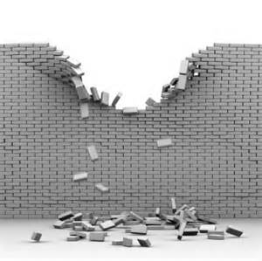
When all heed the call, the walls will fall.
Trust and Obey. God gives the victory!

Slide 28
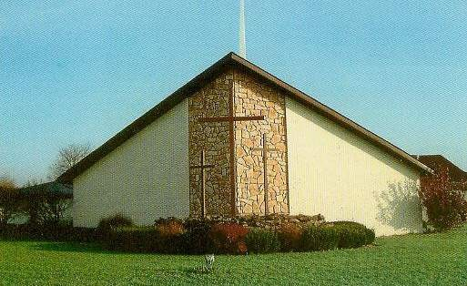
Let’s be a church that obeys god’s commands

