Slide 2
I. MOTHERHOOD: WHAT A GIFT THE GIFT OF LIFE

Slide 3
GENESIS 1:26a, 27
Then God said, “Let us make mankind in our image, in our likeness.” So God created mankind in His own image, in the image of God He created them; male and female he created them.

Slide 4
PSALM 139:13-17
¹³ For you created my inmost being; you knit me together in my mother’s womb.
¹⁴ I praise you because I am fearfully and wonderfully made; your works are wonderful, I know that full well.
¹⁵ My frame was not hidden from you when I was made in the secret place, when I was woven together in the depths of the earth.

Slide 5
¹⁶ Your eyes saw my unformed body; all the days ordained for me were written in your book before one of them came to be. ¹⁷ How precious to me are your thoughts, God!

Slide 6
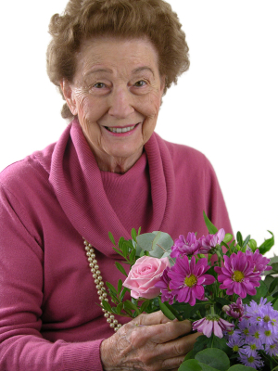
II. WE WANT TO CELEBRATE OUR MOTHERS AND SAY “THANK YOU!”

Slide 7
III. WE ARE “DUSTY” CREATIONS, WE CHOOSE TO REMEMBER THE GOOD.

Slide 8
PSALM 103:13-18
¹³ As a father has compassion on his children, so the Lord has compassion on those who fear him; ¹⁴ for he knows how we are formed, he remembers that we are dust. ¹⁵ The life of mortals is like grass, they flourish like a flower of the field;

Slide 9
¹⁶ the wind blows over it and it is gone, and its place remembers it no more.
¹⁷ But from everlasting to everlasting the Lord’s love is with those who fear him, and his righteousness with their children’s children—
¹⁸ with those who keep his covenant and remember to obey his precepts.

Slide 10
IV. THE LORD HAS BLESSED US AND PLACED US IN LIFE AND TIME BY HIS DESIGN…BE THANKFUL!

Slide 11
¹ Shout for joy to the Lord, all the earth.
² Worship the Lord with gladness; come before him with joyful songs.
³ Know that the Lord is God. It is he who made us, and we are his^{[a]}; we are his people, the sheep of his pasture.

Slide 12
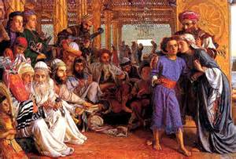
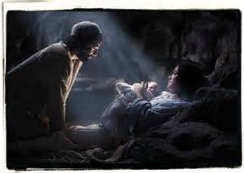
V. LIFE IS FULL OF CHALLENGES, EVEN MARY HAD CHALLENGES LUKE 2:41-25

Slide 13
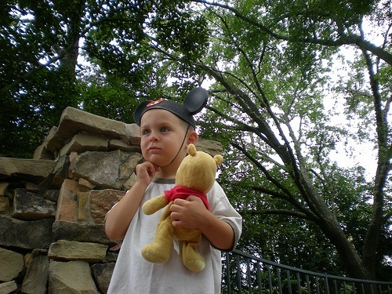

Slide 14
VI. LIFE IS FULL OF CHALLENGES AND DIFFICULTIES, CHOOSE GOD’S WAY OF FAITH, TRUST AND JOY.

Slide 15
JAMES 1:2-5
² …when troubles of any kind come your way, consider it an opportunity for great joy. ³ For you know that when your faith is tested, your endurance has a chance to grow. ⁴ So let it grow, for when your endurance is fully developed, you will be perfect and complete, needing nothing. ⁵ If you need wisdom, ask our generous God, and He will give it to you. He will not rebuke you for asking.

Slide 16
VII. ALWAYS SERVE AND WORSHIP GOD WHO LOVES YOU WITH AN UNFAILING LOVE.

Slide 17
PSALM 27:8,10
v. 8 - My heart says of you, “Seek his face!” Your face, Lord, I will seek.
v. 10 - Though my father and mother forsake me, the Lord will receive me.

Slide 18
VIII. CONFESS AND RESOLVE TO FOLLOW CHRIST IN HUMILITY, FORGIVENESS AND LOVE.

Slide 19
“Our heavenly Father, who by thy love has made us, and through your love has kept us, and in your love would make us perfectly complete: We humbly confess that we have not loved you with all our heart and soul and mind and strength, and that we have not loved one another as Christ has loved us. Your life is within our souls, but our selfishness has hindered your work in us. We have not lived by faith. We have resisted your Spirit. We have neglected your inspirations…

Slide 20
Forgive what we have been; help us to amend what we are; and in your Spirit direct what we shall be; that you may come into the full glory of your creation, in us and in all men; through Jesus Christ our Lord. Amen.”

Slide 21
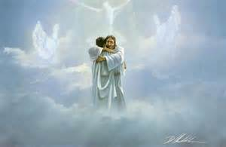
WOMEN OF CROSS ROADS, WE LOVE YOU AND ARE THANKFUL FOR YOU!!!

